Slide 1
Why you´re not ready for containers in production!

Slide 2


Christian Johannsen
Introduction
Solutions Architect EMEA
@cjohannsen81

Slide 3
Overview
Enterprise IT – What is Enterprise and what are their challenges
Containers in Test&Dev– Innovation IT and Software Development
Containers in Production – Operational IT vs. Innovation IT
Automation that travels with the app
Compliance – Testing for every target

Slide 4
Overview
Enterprise IT – What is Enterprise and what are their challenges

Slide 5
A few questions to start with
Who is working for an enterprise company?
Who is running a configuration management tool?
Who is using container technologies in Test/Dev?
Who is using them in production?

Slide 6
Enterprise Companies
What drives a company
Time and Money
Definition of an enterprise company (Wikipedia, too small?)
40-50 Million revenue within the last 12 months
More than 500 employees
IT in these enterprise companies
From back-office, finance and transactional business in the past
To todays customer facing services: contact center, delivery and logistics, banking, healthcare etc.
Different Responsibilities in the IT department:
Infrastructure teams (Server, Client)
Network teams
Application and Development teams
Security teams
…

Slide 7
Enterprise IT
IT is still seen as an enterprise function with frequently innovations driven by the business
Today is different
Enable new business thru technology (Uber, PayPal, LinkedIn)
Running operations more efficiently
Making sense of a rapidly evolving landscape
Emerging view of two integrated organizations:
Innovation IT
Drives new technologies to enable new or faster business
Operational IT
Understands the need of low risk, stable and secury day-to-day services to enable business
Enterprise Companies need to live in both worlds and have to balance them

Slide 8
Configuration Management
Configuration Management allows you to build a system that´s known, trusted and does not rely on the specific knowledge of the development team.
Often referred also as „IT Automation“
Key benefits are:
Increased efficiency and stability
Historic records of config changes and system states
Enhanced system reliability and faster configuration issue detection
Decreased risk and greater security
Efficient change management
Faster restoration of services and stacks

Slide 9
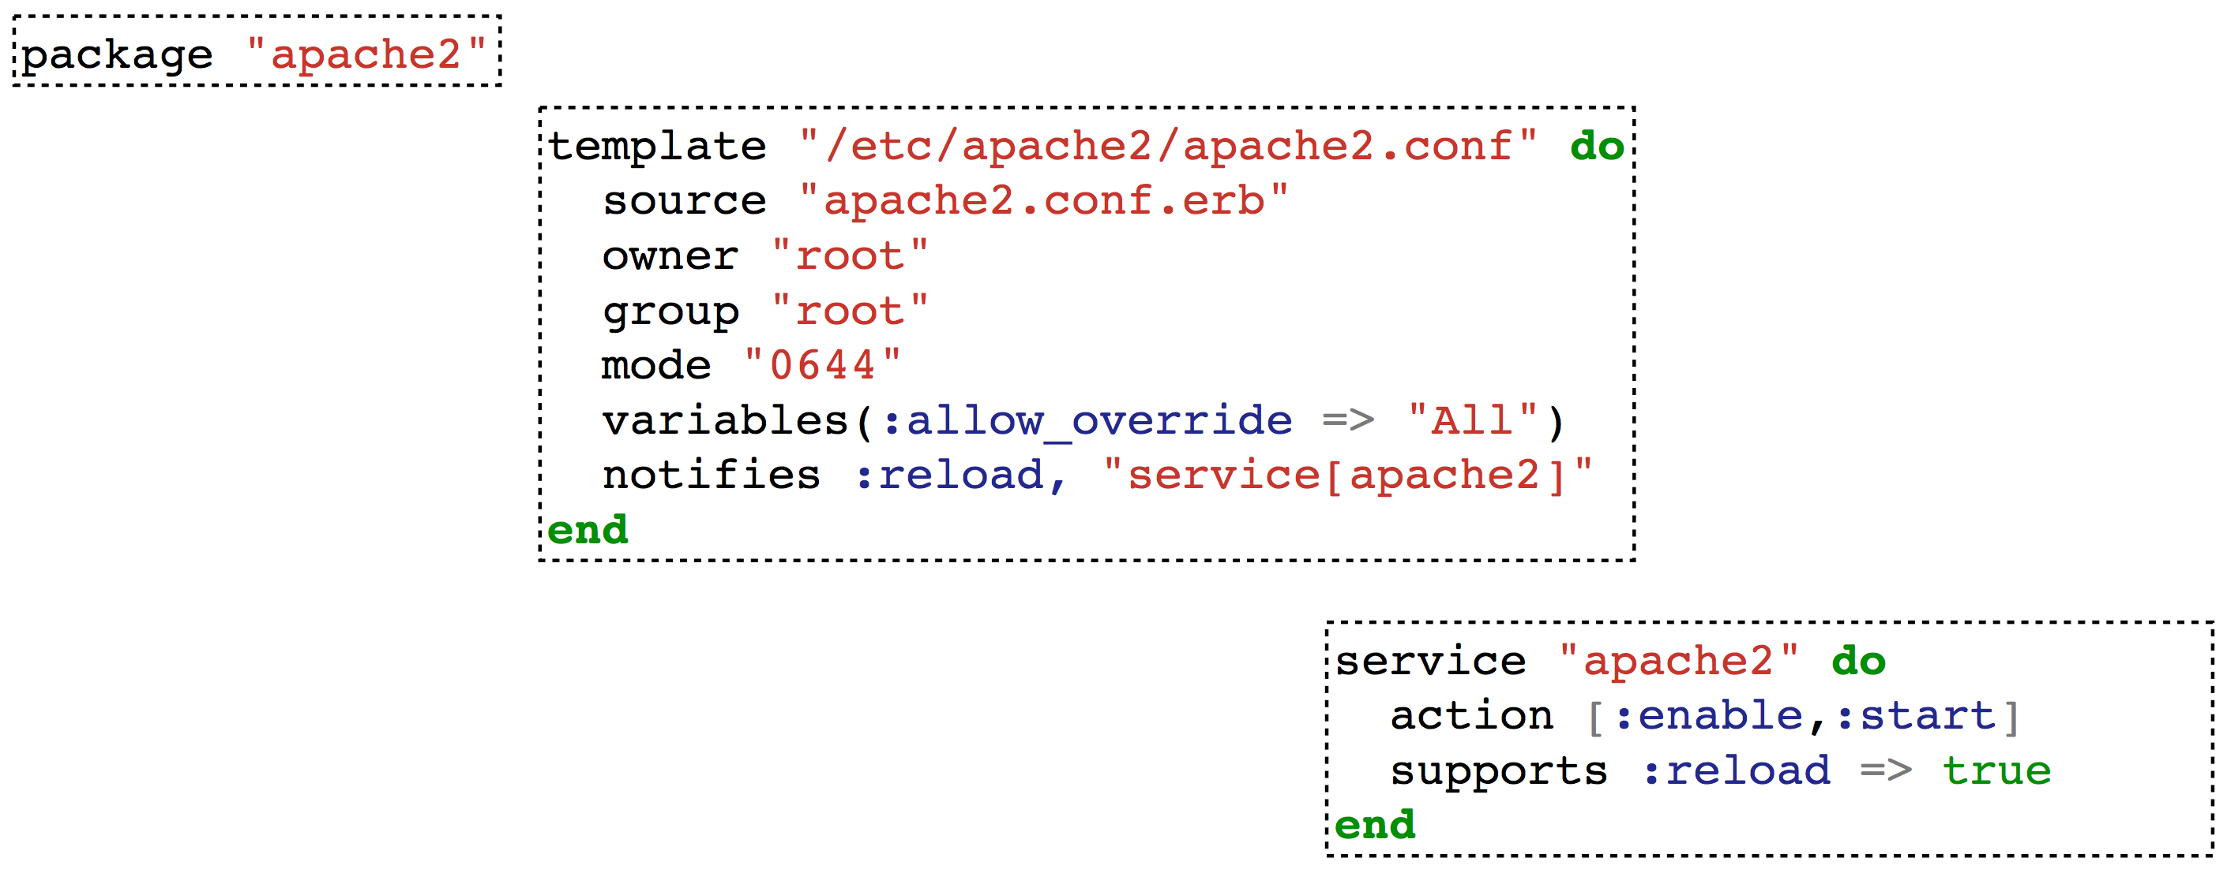
Chef – Infrastructure Automation
Chef Infrastructure Automation is Infrastructure as Code
Programmatically provision and configure components
Treat like any other code base
Reconstruct business from a code repository
Each Node complies with the policy included in each Node’s run list

Slide 10

Who cares?

Slide 11
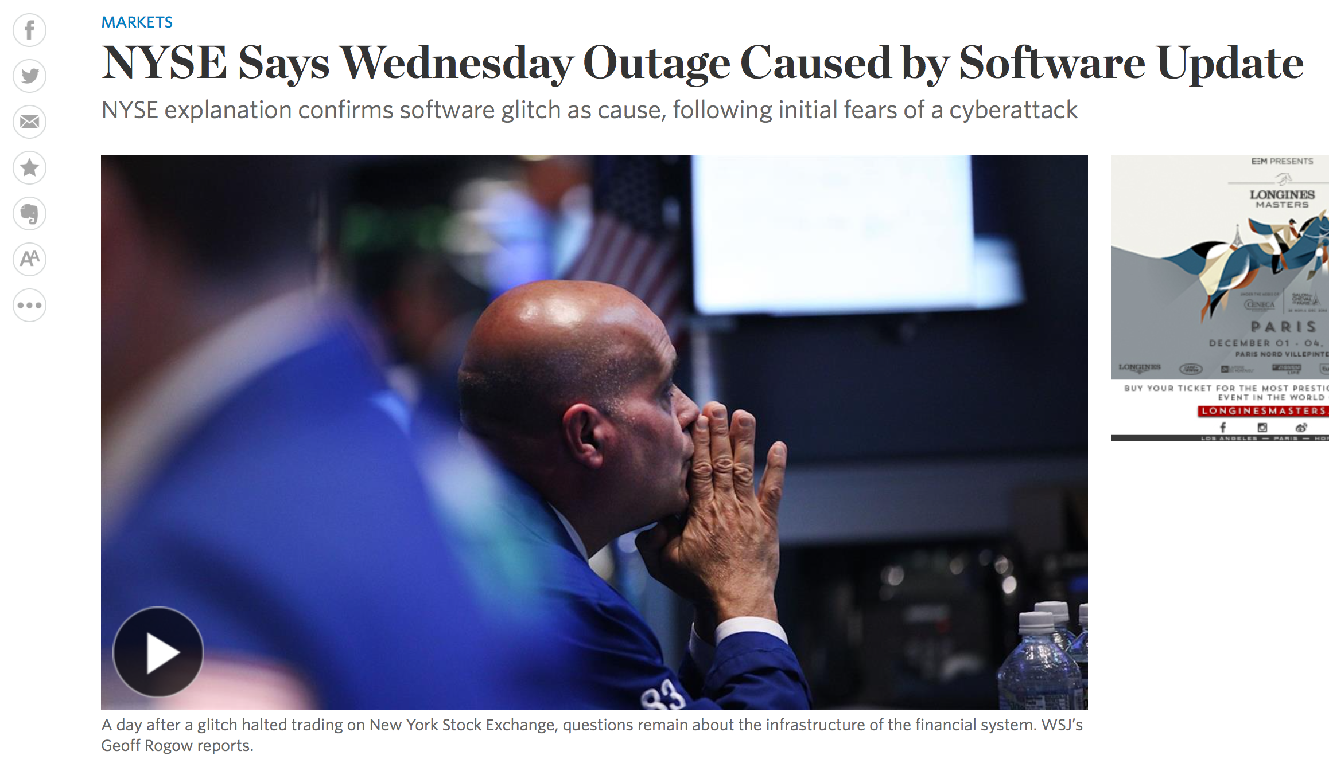
Real-Life examples
NYSE faulty software update causes 3.5 hours suspension
https://www.theguardian.com/business/2015/jul/09/nyse-shutdown-cause-engineers-wrong-software

Slide 12
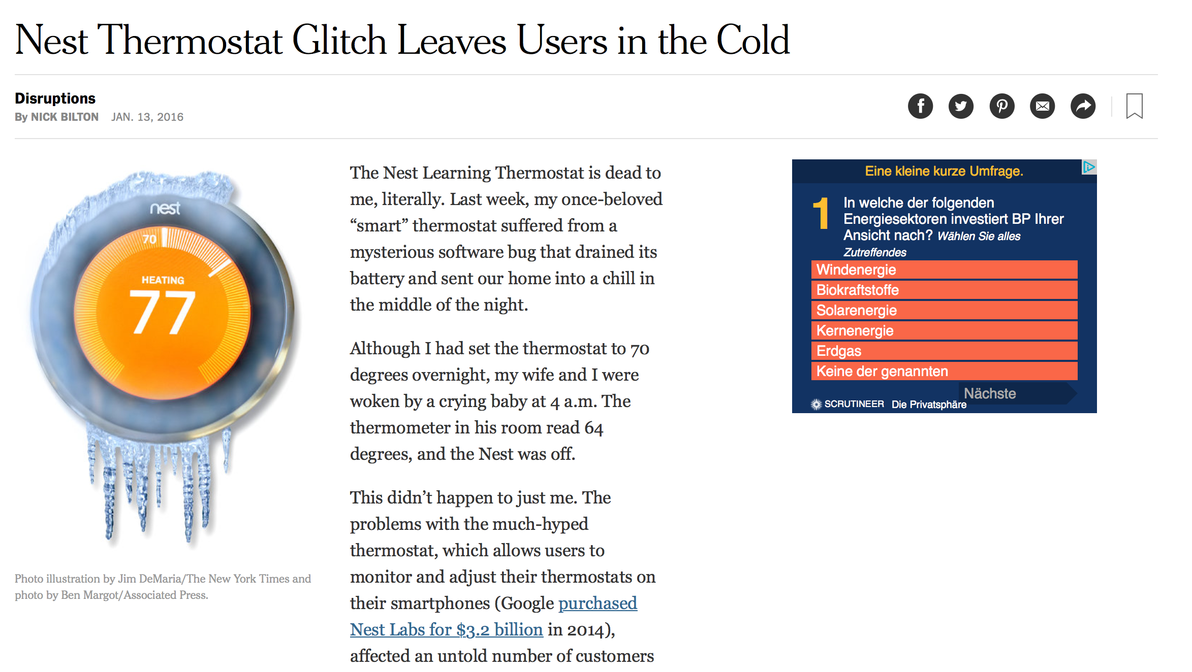
Real-Life examples
NEST Thermostat Glitch leaves users out in the cold
http://www.nytimes.com/2016/01/14/fashion/nest-thermostat-glitch-battery-dies-software-freeze.html?_r=0

Slide 13
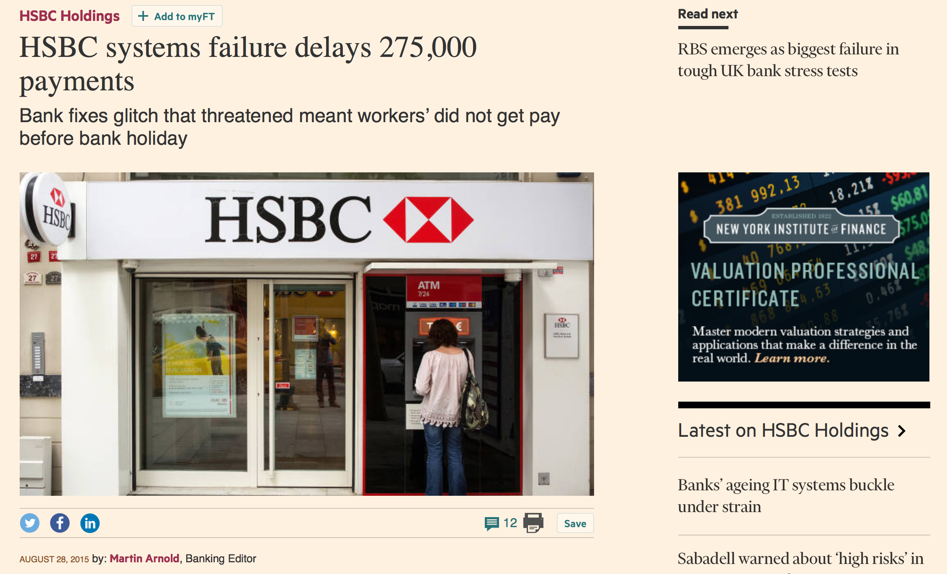
Real-Life examples
HSBC suffers major online banking failure
https://www.ft.com/content/9657d306-4d7c-11e5-b558-8a9722977189

Slide 14
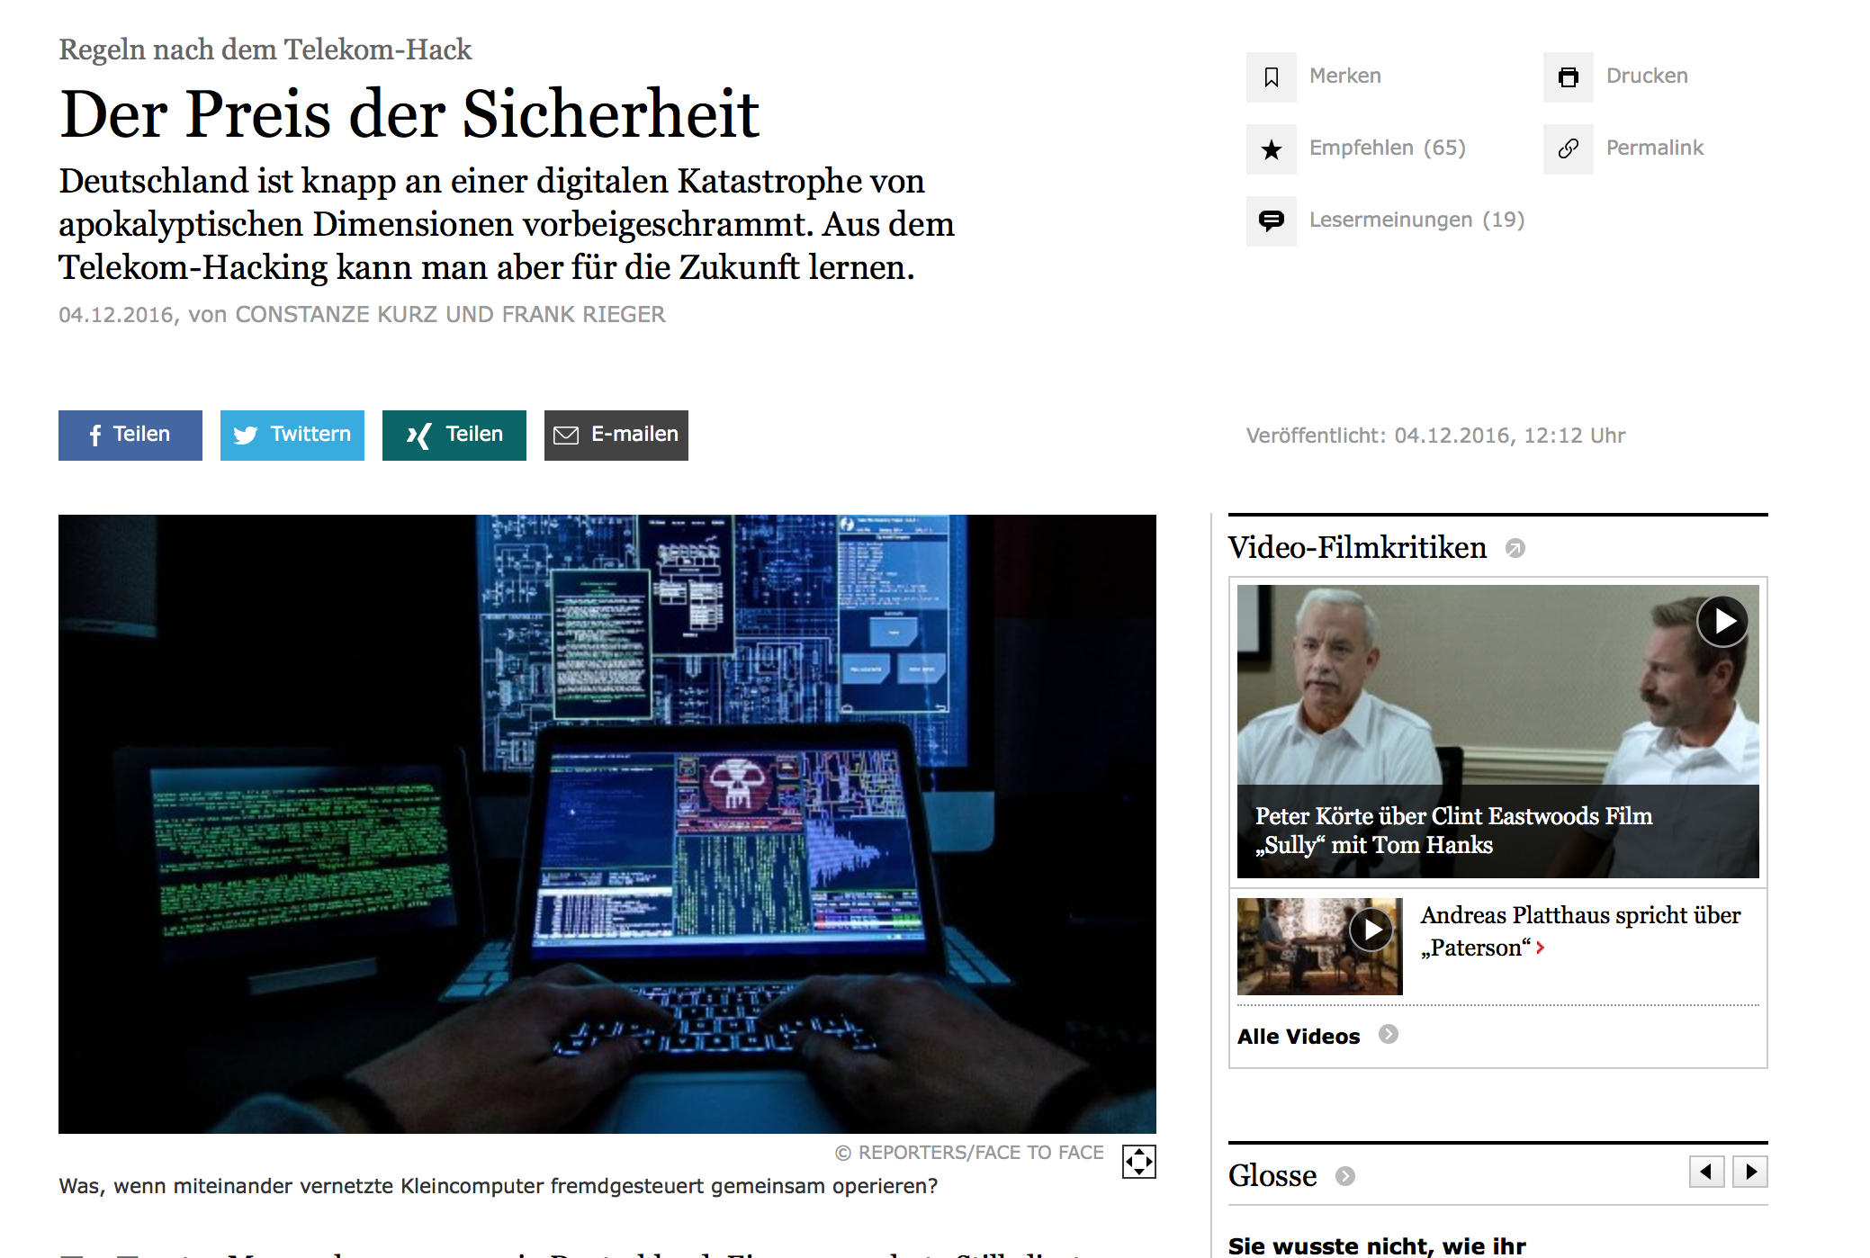
Real-Life examples
Deutsche Telekom faces hacker attack
http://www.faz.net/aktuell/feuilleton/medien/nach-dem-telekom-hacking-der-preis-der-sicherheit-14556876.html

Slide 15

Unreal example?
fsociety hacks five steel mountain facilities
https://en.wikipedia.org/wiki/Mr._Robot_(TV_series)

Slide 16
Overview
Enterprise IT – What is Enterprise and what are their challenges
Containers – Innovation IT and Test/Dev

Slide 17
Okay, we got it! But why containers?
Containers offer an alternative approach to server virtualization
Package your application into a standardized unit for software development
Containers share the kernel with other containers, running as isolated processes in the user space on the host operating system
App
App
App
Bins/Libs
Bins/Libs
Bins/Libs
App
App
App
Guest OS
Guest OS
Guest OS
Bins/Libs
Bins/Libs
Bins/Libs
Container
Container
Container
Hypervisor
Docker Engine
Host Operating System
Host Operating System
Infrastructure
Infrastructure

Slide 18
Containers in Test/Dev environments
Continuous Integration (CI) describes a practice were developers ship codes as often as possible and every code commit is tested before and after merged into a repository in an automated fashion
This should minimize the risk of critical issues shipped into production
These so called automated builds run in specific environments (like test/dev)
Containers help developers to simulate production environments in a fast and automated fashion

Slide 19
What´s the value added?
Can help to build a better relationship between Operations and Development (Contract)
Cheaper and Faster then most of the virtualization technologies
Virtualization Technologies are “fat” as they emulate virtual hardware
Containers just abstract the operating system kernel using LXC userspace tools
Famous container technologies: Docker, rkt (CoreOs)
Cropped Container OS examples:
CoreOs, Project Atomic (RedHat), Snappy Ubuntu (Canonical), Project Photon (Vmware)
Easy creation of images (Containers are an instance of an image)
Images can be stored in repositories like code artifacts and pushed/pulled
Images are immutable, new images are created when updating/changing anything

Slide 20
Overview
Enterprise IT – What is Enterprise and what are their challenges
Containers in Test&Dev– Innovation IT and Software Development
Containers in Production – Operational IT vs. Innovation IT

Slide 21
Containers in Production environments
With containers in Test/Dev there´s the wish to use the same easy mechanism in production
With this there are a few challenges:
Is the Service or Application container native?
A container-native application is designed and built around the lifecycle of containers and
considers containers to be first class citizens
What is your production workflow?
A virtual machine is updated in their lifetime and their application as well
How are applications released into production?
Using containers in Test/Dev may need a CI/CD pipeline to release them into production
How are containers set up in production?
Choice of Kernel, Network, Security, Access and Hardening
Service-Discovery (multiple Containers with static ports for example)

Slide 22

Containers in Production environments
Learn the OS
Learn its package manager
Learn its basic configuration
Learn shell scripting
Write a Dockerfile for your service
Learn docker-compose or equivalent
Install and learn Kubernetes
Install and learn Mesosphere or equivalent
Write service discovery behavior
etc.

Slide 23
Container and Config-Management?!
How is Chef helpful with containers today?
✓
✓
✓
Infrastructure setup
Runtime setup and management
Test and dev tooling
✓
✓
Continuous delivery principles through Delivery
Image building

Slide 24




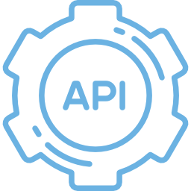
What resources are available?
Documentation on the docs.chef.io website
Test kitchen Docker driver
Docker community cookbook in Supermarket
Kubernetes and Mesos cookbooks also available
Docker API Ruby gem for API interactions in a recipe

Slide 25

But there were more challenges!
That’s what we call the “learning cliff”
Production
Security
Code Quality
Container Hosting
Peer Discovery
Config Changes
Supervision
Monitoring
Rolling Deployment
Networking
Internal Registry
Workload Placement
The Container Learning Cliff
Development

Slide 26
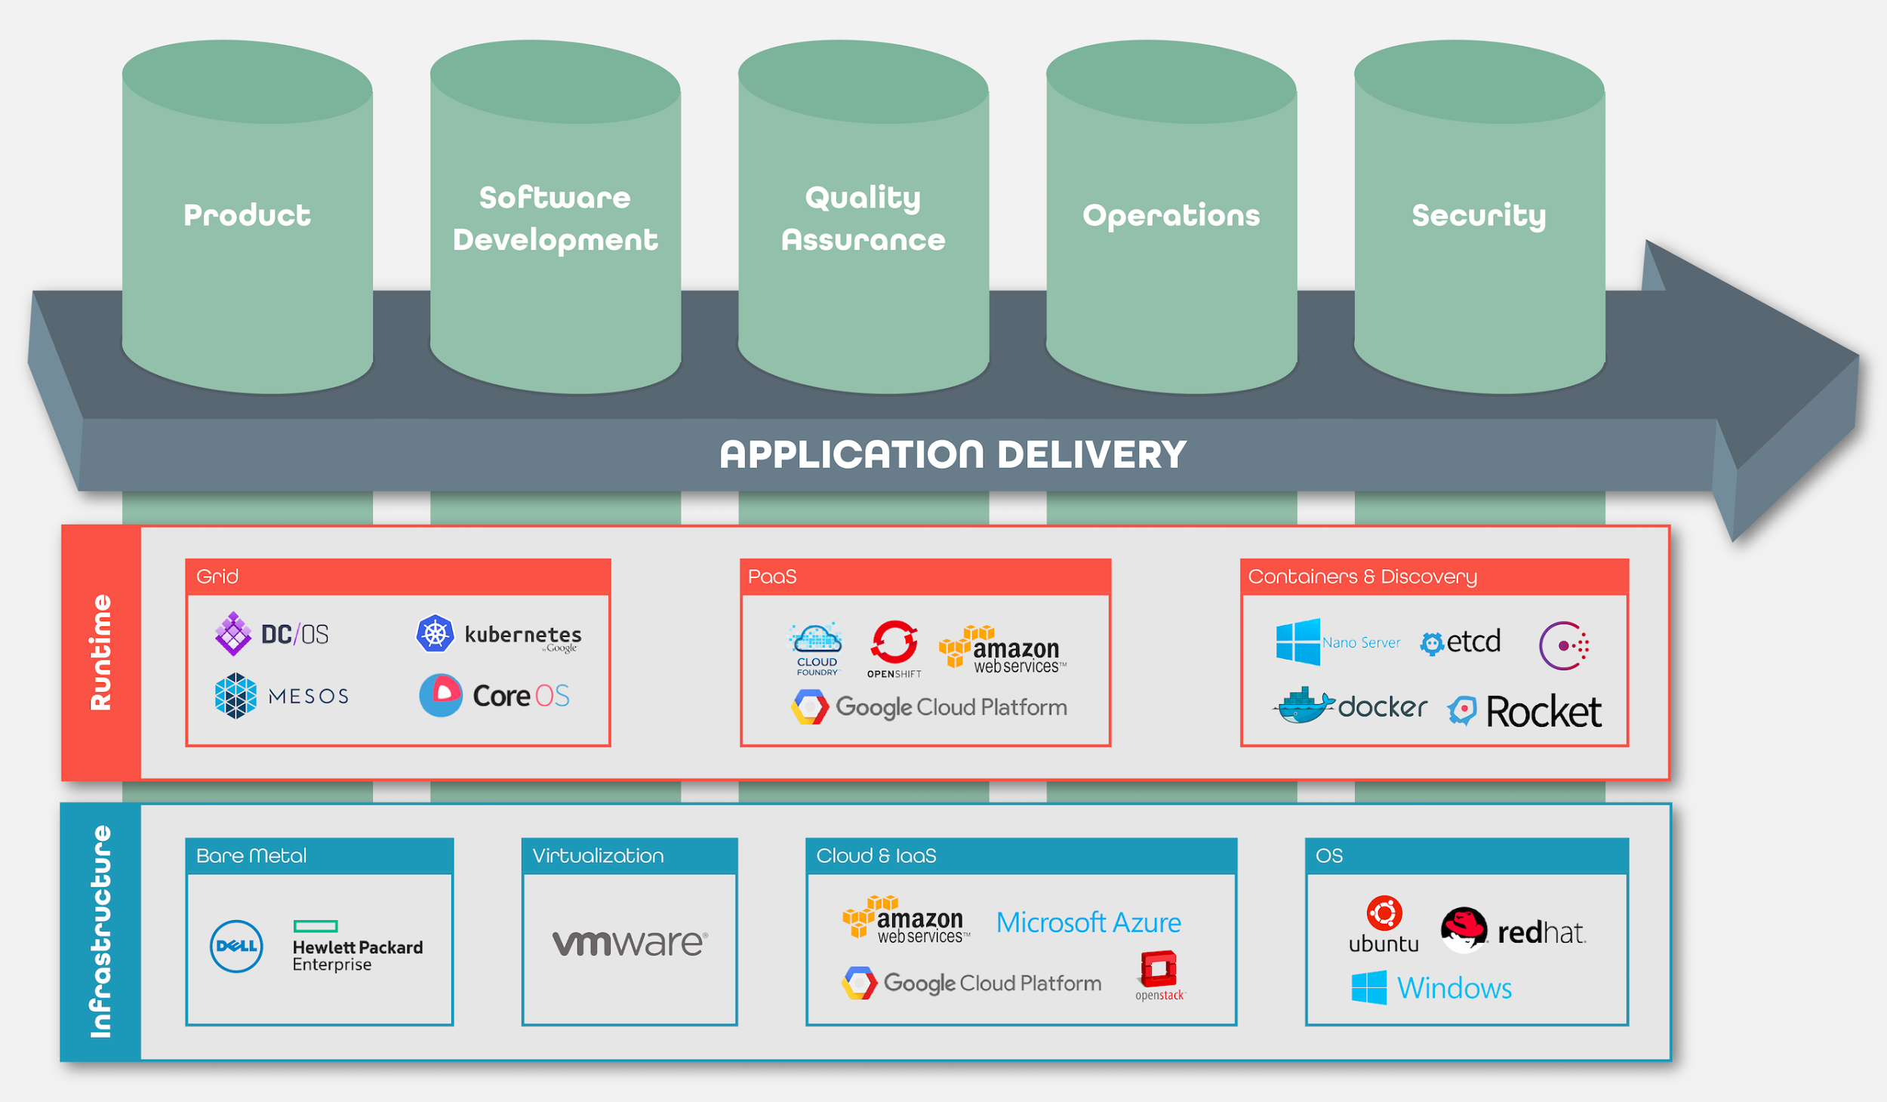
Infrastructure first deployments

Slide 27
Infrastructure first deployments
Most approaches, including containers, start with an infrastructure-first approach
The operating system and platform choices matter up-front and they are tightly bound to decisions made in your application code
A bunch of independent tools to bring your app to life
Those choices are different based upon your platform
you’re still committed to using the toolset for that platform and developing the way that platform wants you to code

Slide 28
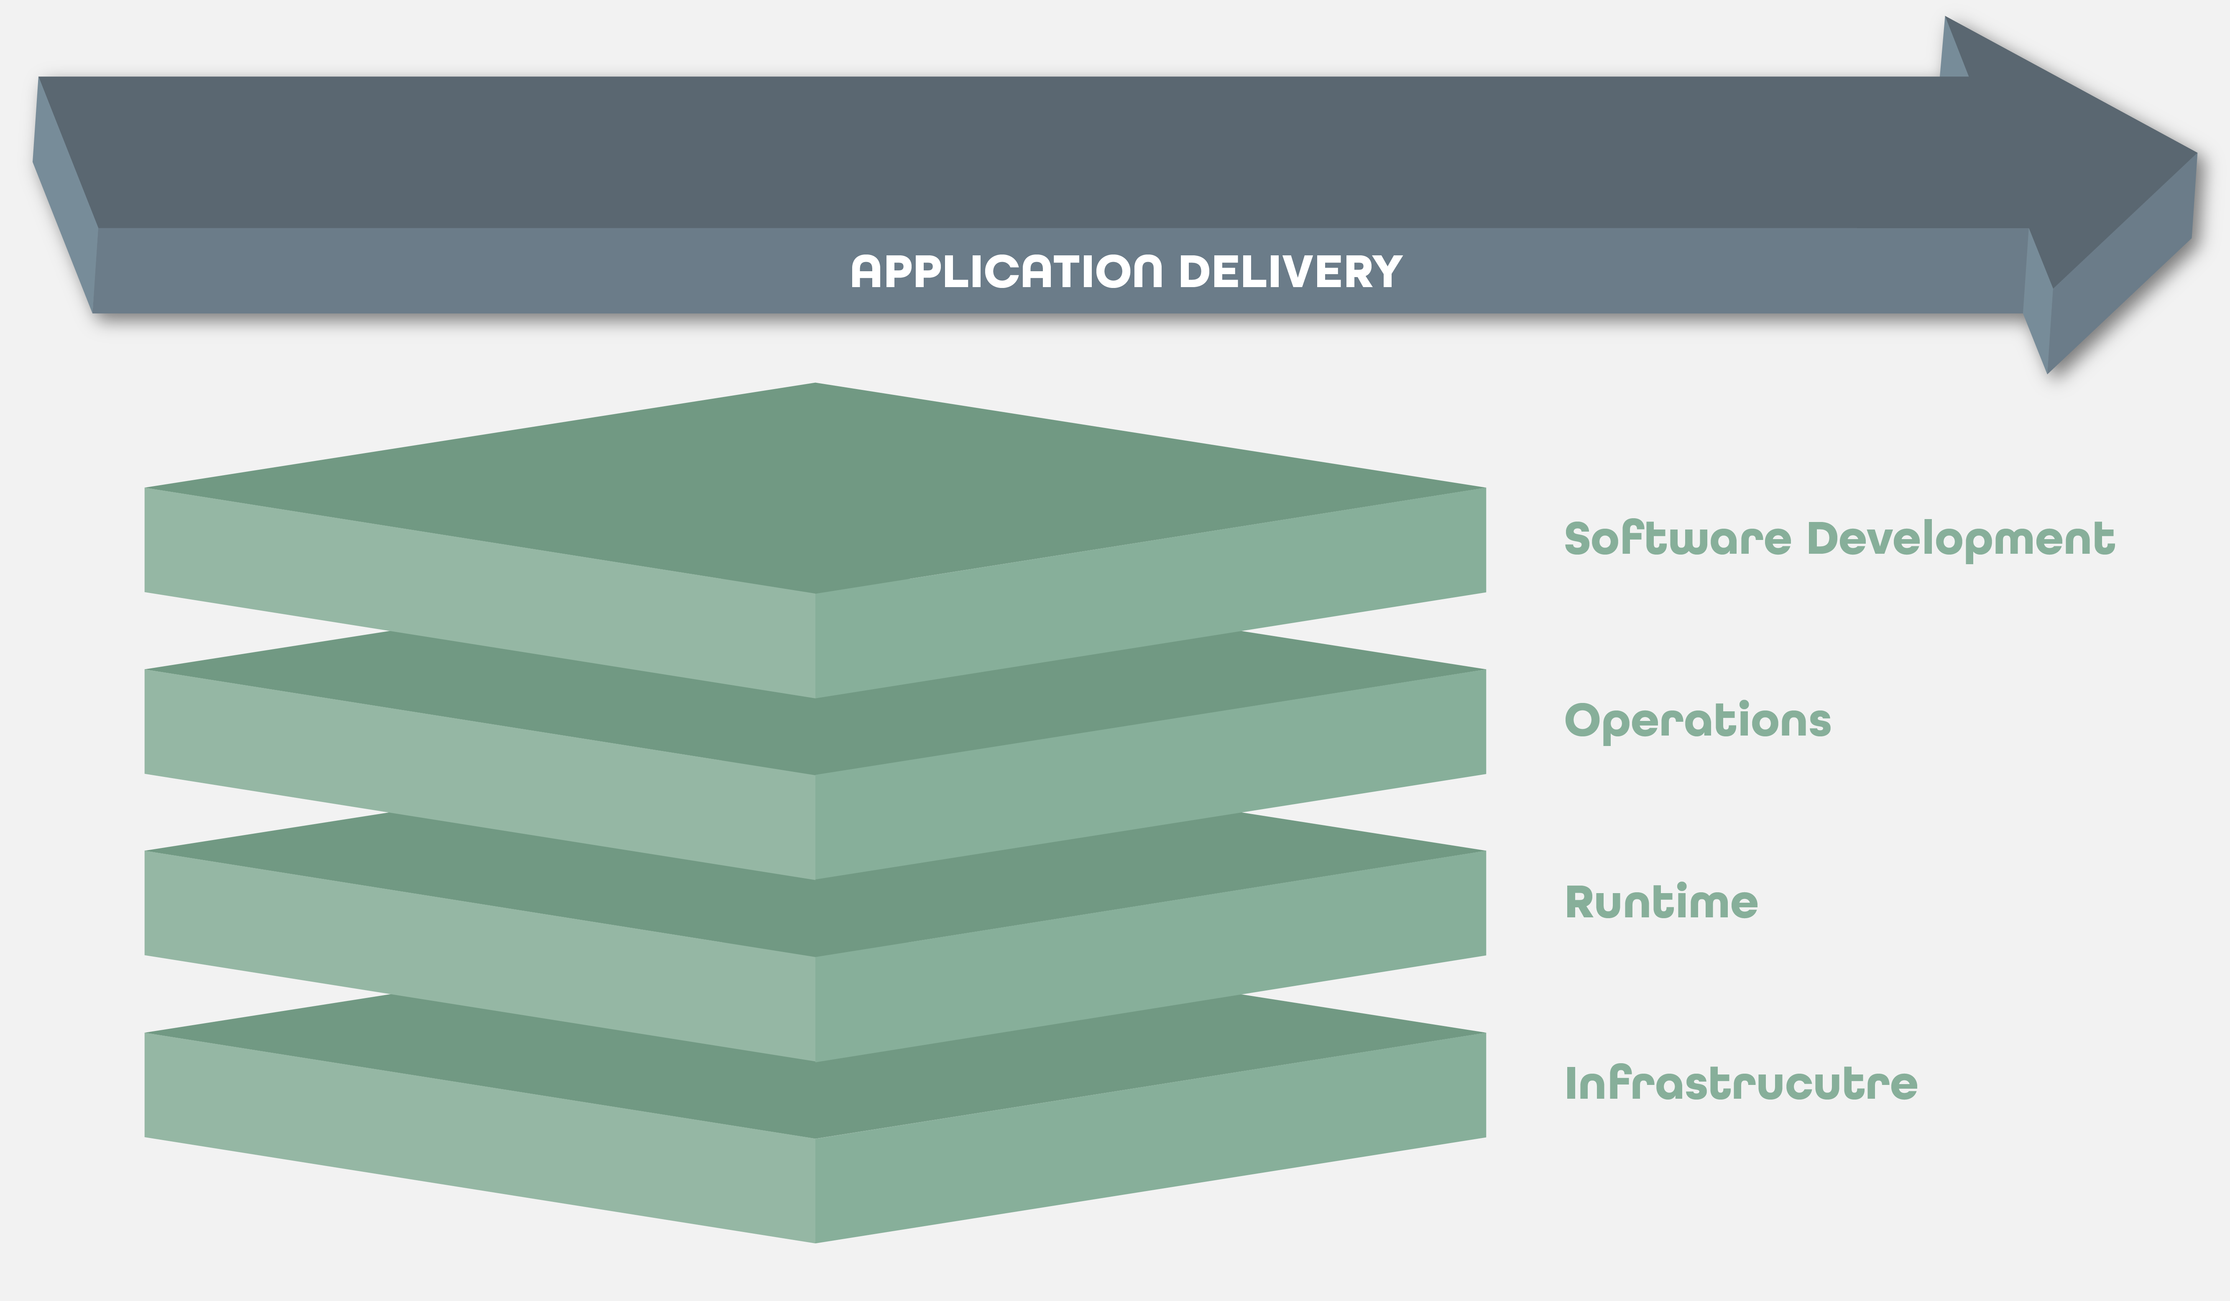
Application first approach

Slide 29
Application first approach
Take an application, wrap it in a layer of application automation
The resulting package can be deployed on the infrastructure or runtime that suits it best
Docker, Kubernetes, Mesos etc.
If your application has hard requirements on physical infrastructure (SAN settings, network topologies, GPUs, etc.), you can deploy it there, and manage it the same way you manage the software that deploys on top of a PaaS, or in a container.

Slide 30
Overview
Enterprise IT – What is Enterprise and what are their challenges
Containers in Test&Dev– Innovation IT and Software Development
Containers in Production – Enterprise IT rules
Automation that travels with the app

Slide 31

Automation that “travels” with the App

Slide 32
Habitat components
Habitat Studio - an application packager
Habitat Plans - instructions to download, compile, and install
Habitat Depot - a place to upload and download your app packages
Habitat Supervisor - an intelligent runtime with deployment coordination and service discovery built in

Slide 33
Habitat components
Habitat Studio - an application packager

Slide 34
Habitat components
Habitat Studio - an application packager
Habitat Plans - instructions to download, compile, and install

Slide 35
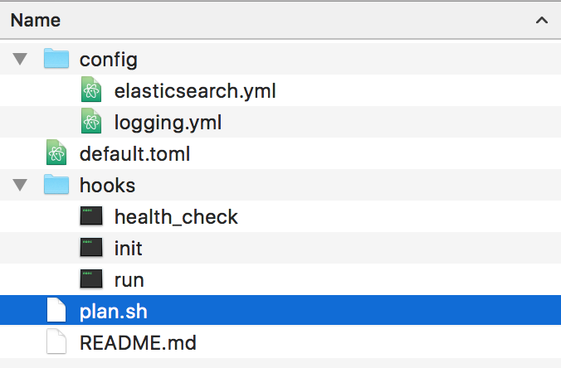
Habitat packaging
Habitat packaging is done inside the studio
Packages are created via:
A plan.sh to define how to build the software using standard BASH.
Configuration templates for the software, using Handlebars.js
Configuration defaults, using TOML
Hooks which define supervisor behavior for initializing, running, defining a health check, etc.
Built Packages can be Dockerized to generate a Docker Image

Slide 36



Habitat plan
Package Format (.hart)
Plan
Artifact
Packaging an application starts with a plan. A Plan is as simple to create as a Dockerfile
Start by launching the isolated Build environment called a “Studio”
Enter the studio (hab-studio enter)
Define your Plan (vim plan.sh) to define the software build from source using standard BASH
Define the Configuration template for the software, using Handlebars (logicless scripting language)
Define the Configuration defaults, using TOML (configuration language)
Define Hooks for supervisor behavior: initializing, running, defining a health check, etc
Create Signing Keys for your Origin (hab origin key generate myOrigin)
Build your Artifact (build myOrigin/myPlan)

Slide 37
Habitat components
Habitat Studio - an application packager
Habitat Plans - instructions to download, compile, and install
Habitat Depot - a place to upload and download your app packages

Slide 38


Habitat workflow
Package Format (.hart)
Bare Metal
Containers
Plan
Artifact
Depot
AMI
VM
Packaging an application starts with a plan. A Plan is as simple to create as a Dockerfile
Start by launching the isolated Build environment called a “Studio”
Enter the studio (hab-studio enter)
Define your Plan (vim plan.sh) to define the software build from source using standard BASH
Define the Configuration template for the software, using Handlebars (logicless scripting language)
Define the Configuration defaults, using TOML (configuration language)
Define Hooks for supervisor behavior: initializing, running, defining a health check, etc
Create Signing Keys for your Origin (hab origin key generate myOrigin)
Build your Artifact (build myOrigin/myPlan)
Post-process Artifact for target environments: Docker, Rocket, CloudFoundry, Mesos, Kubernetes, etc...
Run and test Artifact (docker run -ti myOrigin/myPlan)

Slide 39
Habitat components
Habitat Studio - an application packager
Habitat Plans - instructions to download, compile, and install
Habitat Depot - a place to upload and download your app packages
Habitat Supervisor - an intelligent runtime with deployment coordination and service discovery built in

Slide 40

Habitat components
Supervisor: An Intelligent Run-Time Supervisor w/ REST API (hab-sup)
Leader
Supervisor
Supervisor
Depot
Artifact
Supervisor
Supervisor
Initializer
Ring
Stand Alone
Part of an Artifact, the Supervisor manages Application node behavior at runtime, providing automation and intelligence:
Utilizes predefined Plan to manage application behavior
Built in service discovery
Self-organizes with other Supervisor nodes on a Ring into topologies
Rings have no single point of failure
Supervisor executes a variety of hooks for defined behavior:
init, run, health_check, reconfigure, file_update
Supervisor is accessible via REST API:
/config, /health, /status, /gossip, /census, /election

Slide 41
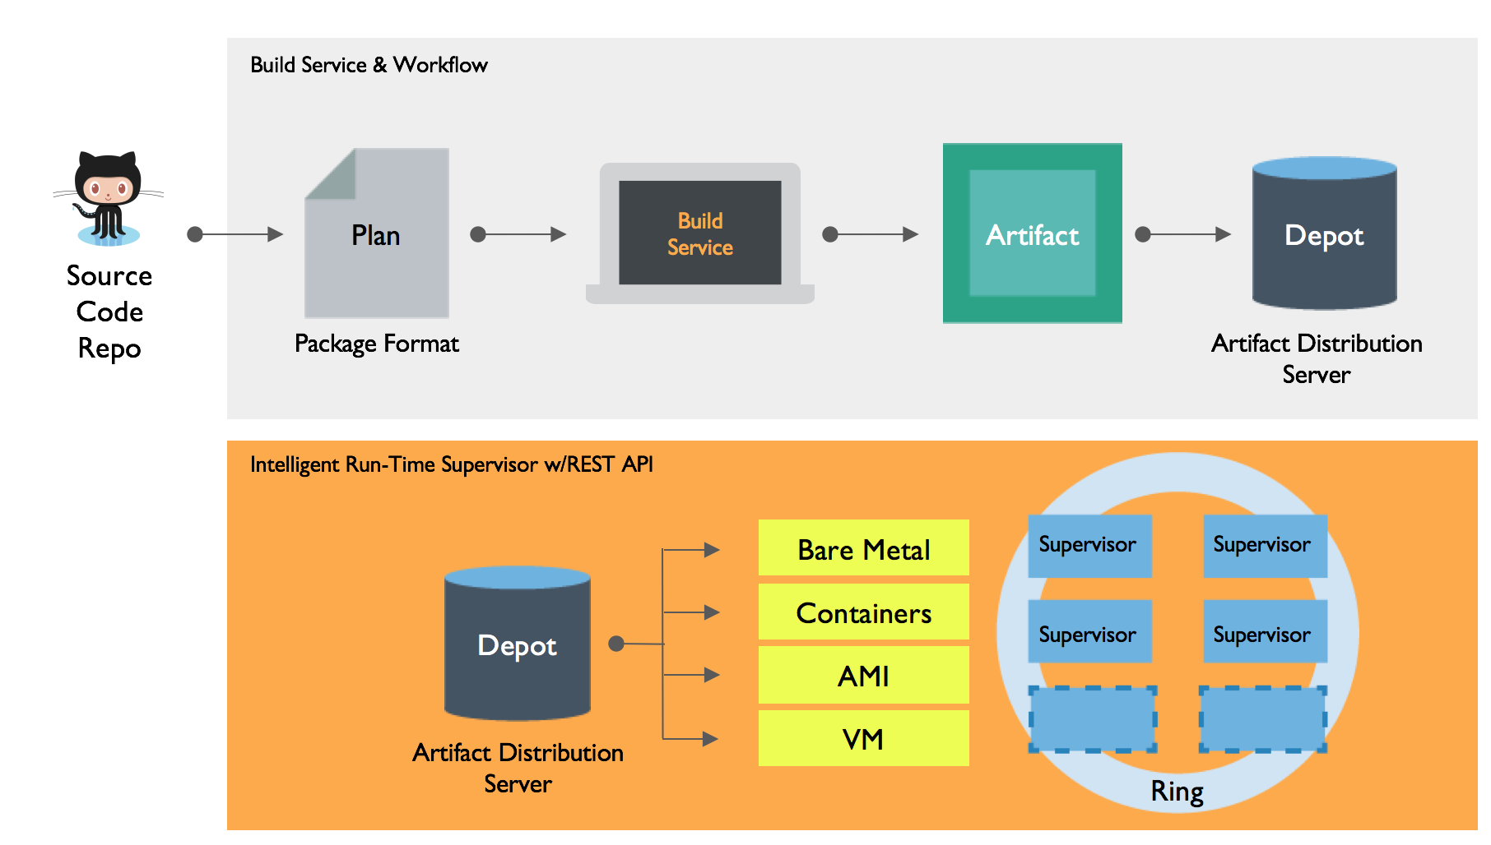
Habitat Summary

Slide 42
Great, but why?
A robust, safe, simple, and secure software packaging system
Independent of target infrastructure
Bundles what your apps need to run and nothing else
Embedded automation choreographs application cluster topology/behavior
Provides continuous deployment without traditional Application Release Automation (ARA) tooling

Slide 43
Overview
Enterprise IT – What is Enterprise and what are their challenges
Containers in Test&Dev– Innovation IT and Software Development
Containers in Production – Operational IT vs. Innovation IT
Automation that travels with the app
Compliance – Testing for every target

Slide 44
What about testing and compliance
Chef offers Compliance thru a language called InSpec
With InSpec you can check your target infrastructure against controls/profiles
In case of docker you can use the native API
describe sshd_config do
its('Protocol') { should cmp 2 }
end
$ inspec exec test.rb
$ inspec exec test.rb -i vagrant.key -t ssh://root@172.17.0.1:11022
$ inspec exec test.rb -t winrm://Admin@192.168.1.2 --password super
$ inspec exec test.rb -t docker://3cc8837bb6a8

Slide 45
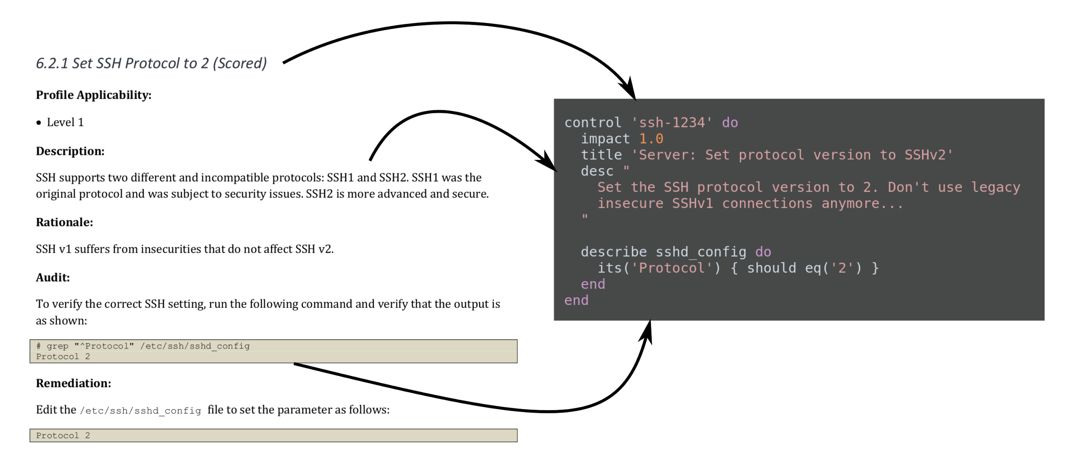
Mapping of Compliance Document to InSpec

Slide 46



I love when a plan come together
Subscription
Includes:
Premium Features
24x7 Support
Supported Content
Success Engineering
Workflow
Compliance
Premium
Features
Visibility
Content (Chef Cookbooks, Habitat Plans, Compliance Profiles)
Infrastructure Automation
Application Automation
Compliance Automation
Open
Source
Software

Slide 47
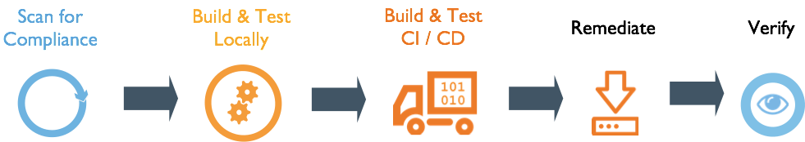
Chef Automate
Chef Infrastructure Automation is Infrastructure as Code
Chef Automate is a full DevOps Configuration management solution including:
Workflow – A Continuous Delivery Pipeline
Visibility - A visualisation of all changes
Compliance – An integrated compliance scanner

Slide 48
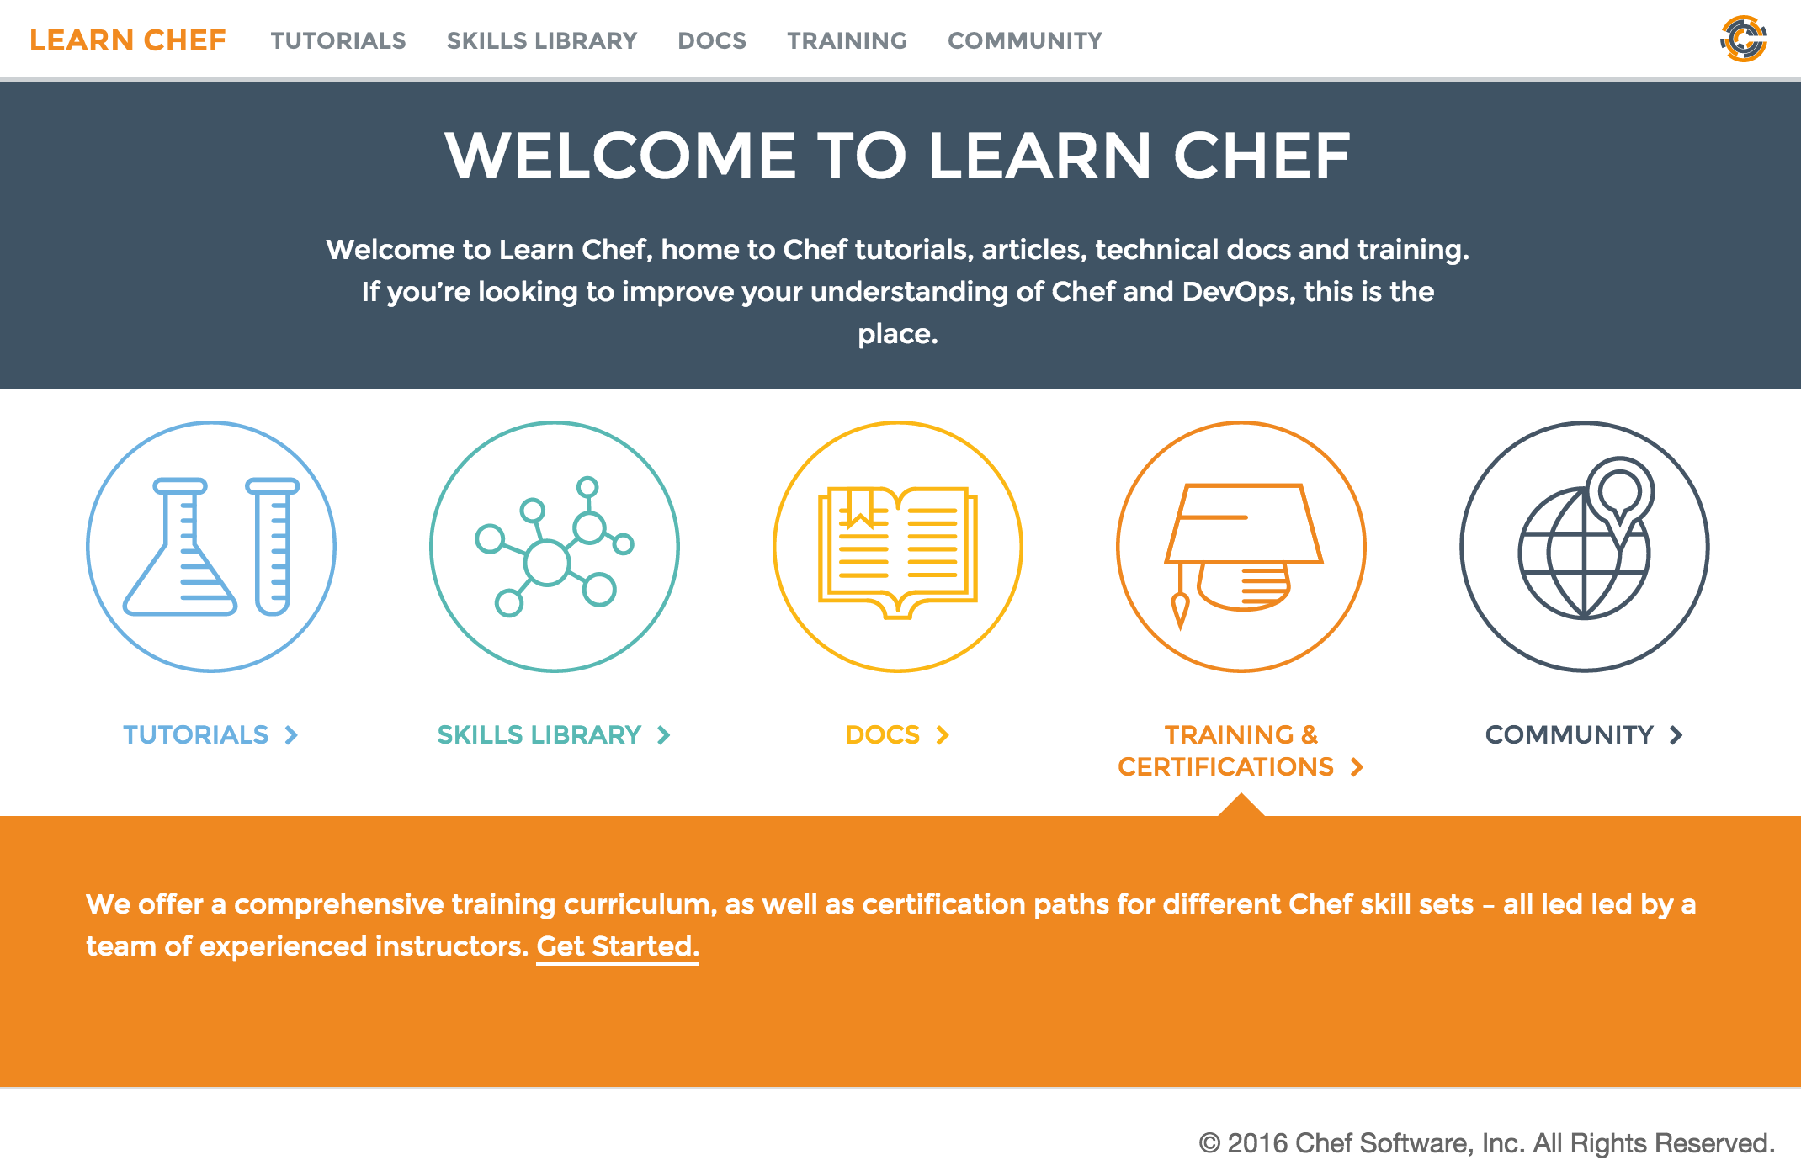
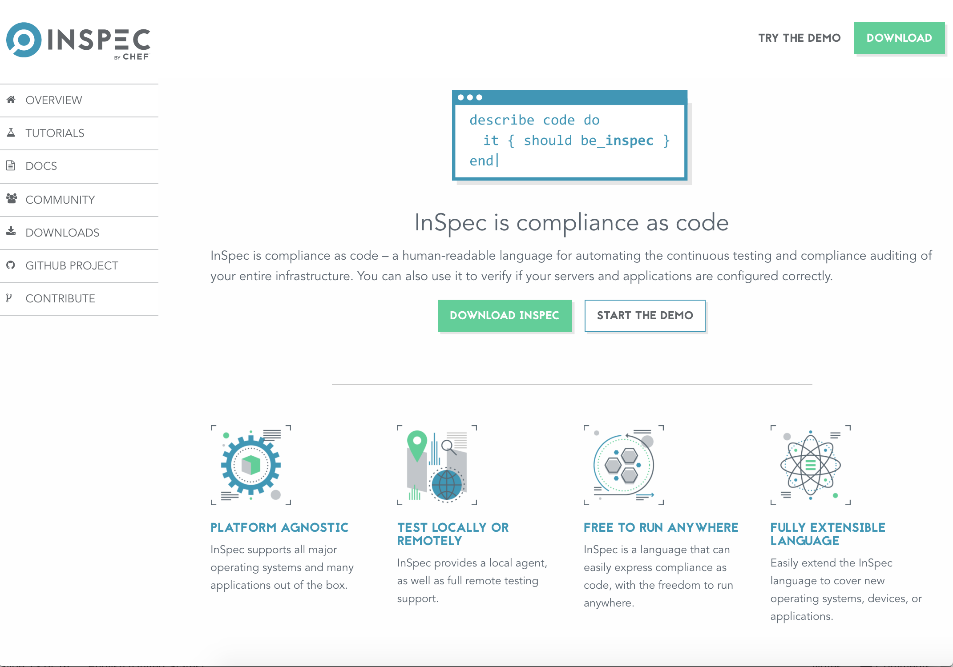
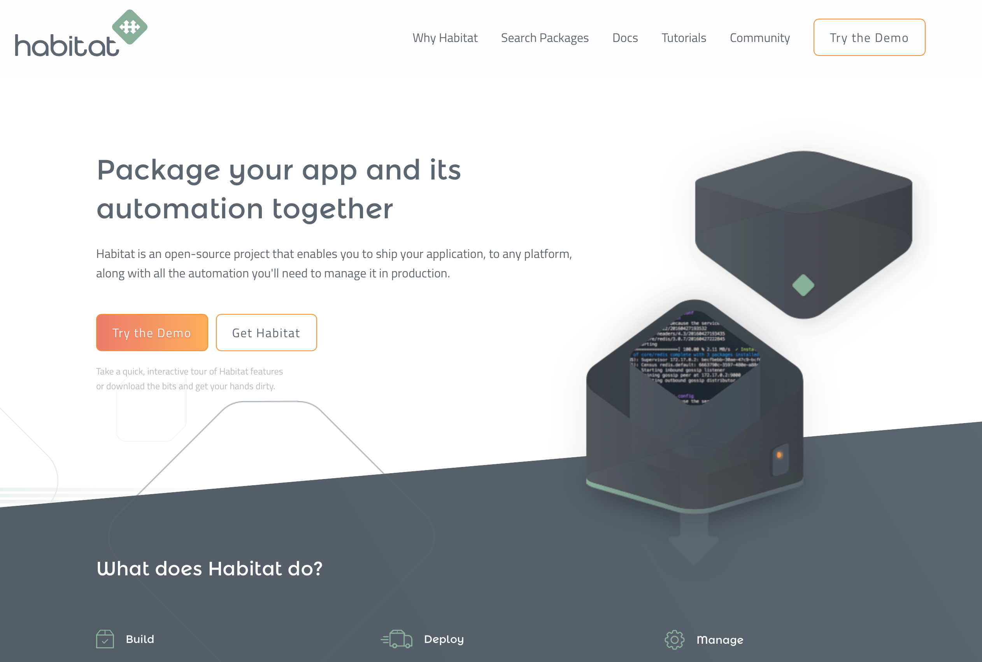
Further Resources
learn.chef.io
More tutorials about Compliance and Inspec
habitat.sh
Hands-On Tutorials
Code examples
Documentation
inspec.io
Hands on tutorials
Extensive documentation
Code examples

Slide 49

Thank you!
Notes:
Automation as a foundation: Adapt the technology for your particular needs…
Chef is infrastructure Automation – create the state you need your systems to be in and push the automation
Inspec on compliance automation – managing policy as code – Rules in place – Verifying the state of the systems is doing what it should be doing..
Habitat – Focused on Application Automation – Application behave the same across the lifecycle of Build, Deploy and Manage..
It helps teams Understands How the application behaves and the applications automates and takes care of itself..
Summary
Chef is focused on the infrastructure automation
Habitat handles the application automation
And Inspec ensures compliance and security across your systems.
Workflow
Premium offering starts with Worflow: is a prescribed and consistent workflow to collaborate and work, hand in hand with all your Automated systems to help build, test, deploy and manage them.
Visibility –
Pulls in the events of the underlying systems, Chef, Habitat, Inspec to manage the environments all the way to the node.. Either ephemeral or long live node. You can search, analyze, Audit and report on what's across your environments- We are marrying the process views to know what’s happening in the process how its going in relations to the underlying environment.
Compliance -
Understand where they sit form a compliance from regulatory and internal compliance perspective. It works with both Workflow and visibility to ensure the systems are managed correctly under these policies.

